Slide 1
Procezo
Presented By,
JMAYMCA009 DEVIKA SUNILKUMAR
JMAYMCA010 DIYA V P
JMAYMCA013 HITHA KRISHNA P R
JMAYMCA034 TINA PAUL C

Slide 2
Introduction
Monitor and manage employee productivity through automated systems and real-time data tracking.
Automate attendance using face recognition for accuracy and efficiency.
Track work activities and emotions to assess stress levels and engagement.
Ensure transparency and accountability in workforce management.
Generate insightful reports to support data-driven decision-making.
Enhance overall organizational efficiency by integrating modules for administration, analysis, and monitoring.

Slide 3
System Overview
Comprehensive Employee Monitoring: Tracks employee activities through face recognition, emotion detection, and system logs (keyboard, process, and screenshots).
Automated Attendance System: Uses face recognition to automatically record login and logout times, ensuring accurate and real-time attendance tracking.
Modular Design: The system is divided into Admin and Website, each handling registration, data management, and visualization of employee information.
Enhanced Management and Security: Provides insights on employee behavior, work performance, and overtime, improving accountability, transparency, and organizational control.

Slide 4
Proposed System
Automated face recognition attendance
Continuous emotion detection
System activity monitoring (logs)
Centralized admin control
Real-time data analysis and reporting
Integrated web and desktop modules
Enhanced productivity and security

Slide 5
Advantages Of Proposed System
Accurate attendance tracking
Real-time emotion monitoring
Improved employee accountability
Automated data collection
Easy performance analysis
Enhanced organizational security
Increased overall productivity

Slide 6
Objectives Of The System
Automated attendance
Activity monitoring
Emotion detection
Transparency and accountability
Data-driven reports
Integrated modules
Productivity improvement

Slide 7
Existing System
Tracks only field employees using mobile applications.
Relies on manual attendance or GPS-based tracking.
Limited monitoring focuses mainly on location and check-in/out times.
No emotion detection or behavior analysis features.
Lacks integration with system logs like keyboard or process tracking.
Provides minimal insights for performance evaluation and decision-making.

Slide 8
Drawbacks Of Existing System
Limited tracking
No emotion analysis
Manual attendance
Low accuracy
Poor data integration
Limited performance insights

Slide 9
Feasibility Study
Operational feasibility – ensures the system is user-friendly and practical for daily use.
Technical feasibility – confirms compatibility with existing hardware and software.
Economic feasibility – verifies the system is cost-effective and beneficial.

Slide 10
Requirements Specification
OS: Windows 7 or above
Front-End: HTML, CSS, JavaScript
Back-End: Python (Django)
Database: MySQL
Server: Apache/WAMP
Tools: VS Code
Browsers: Chrome, Firefox, Internet Explorer
AI Module: CNN for face & emotion detection
Modules: Admin, Staff

Slide 11
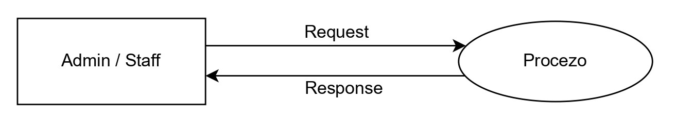
DFD Level 0

Slide 12
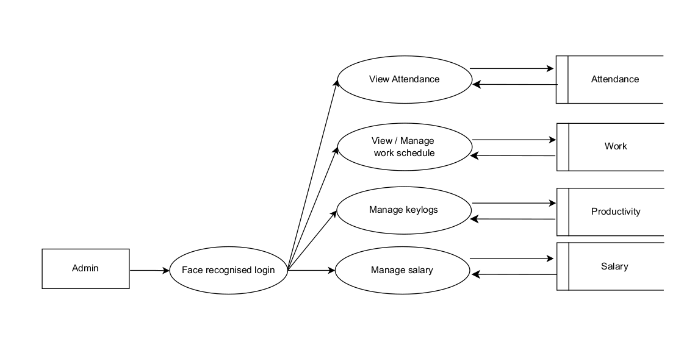
DFD Level 1 - Admin

Slide 13
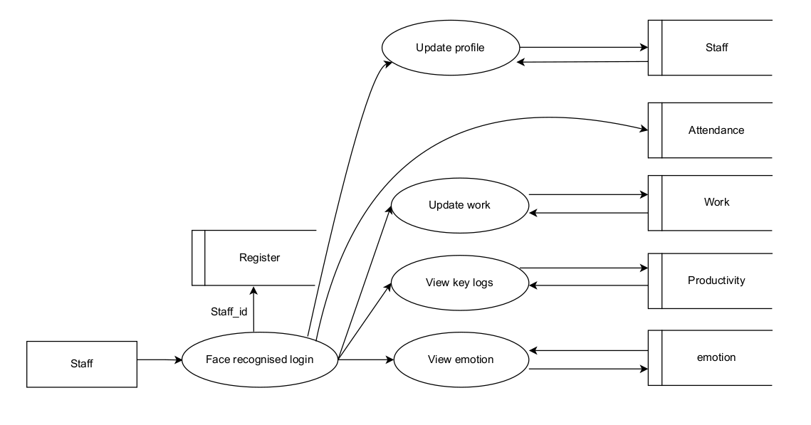
DFD Level 1 - Staff

Slide 14
General Architecture Diagram

Slide 15
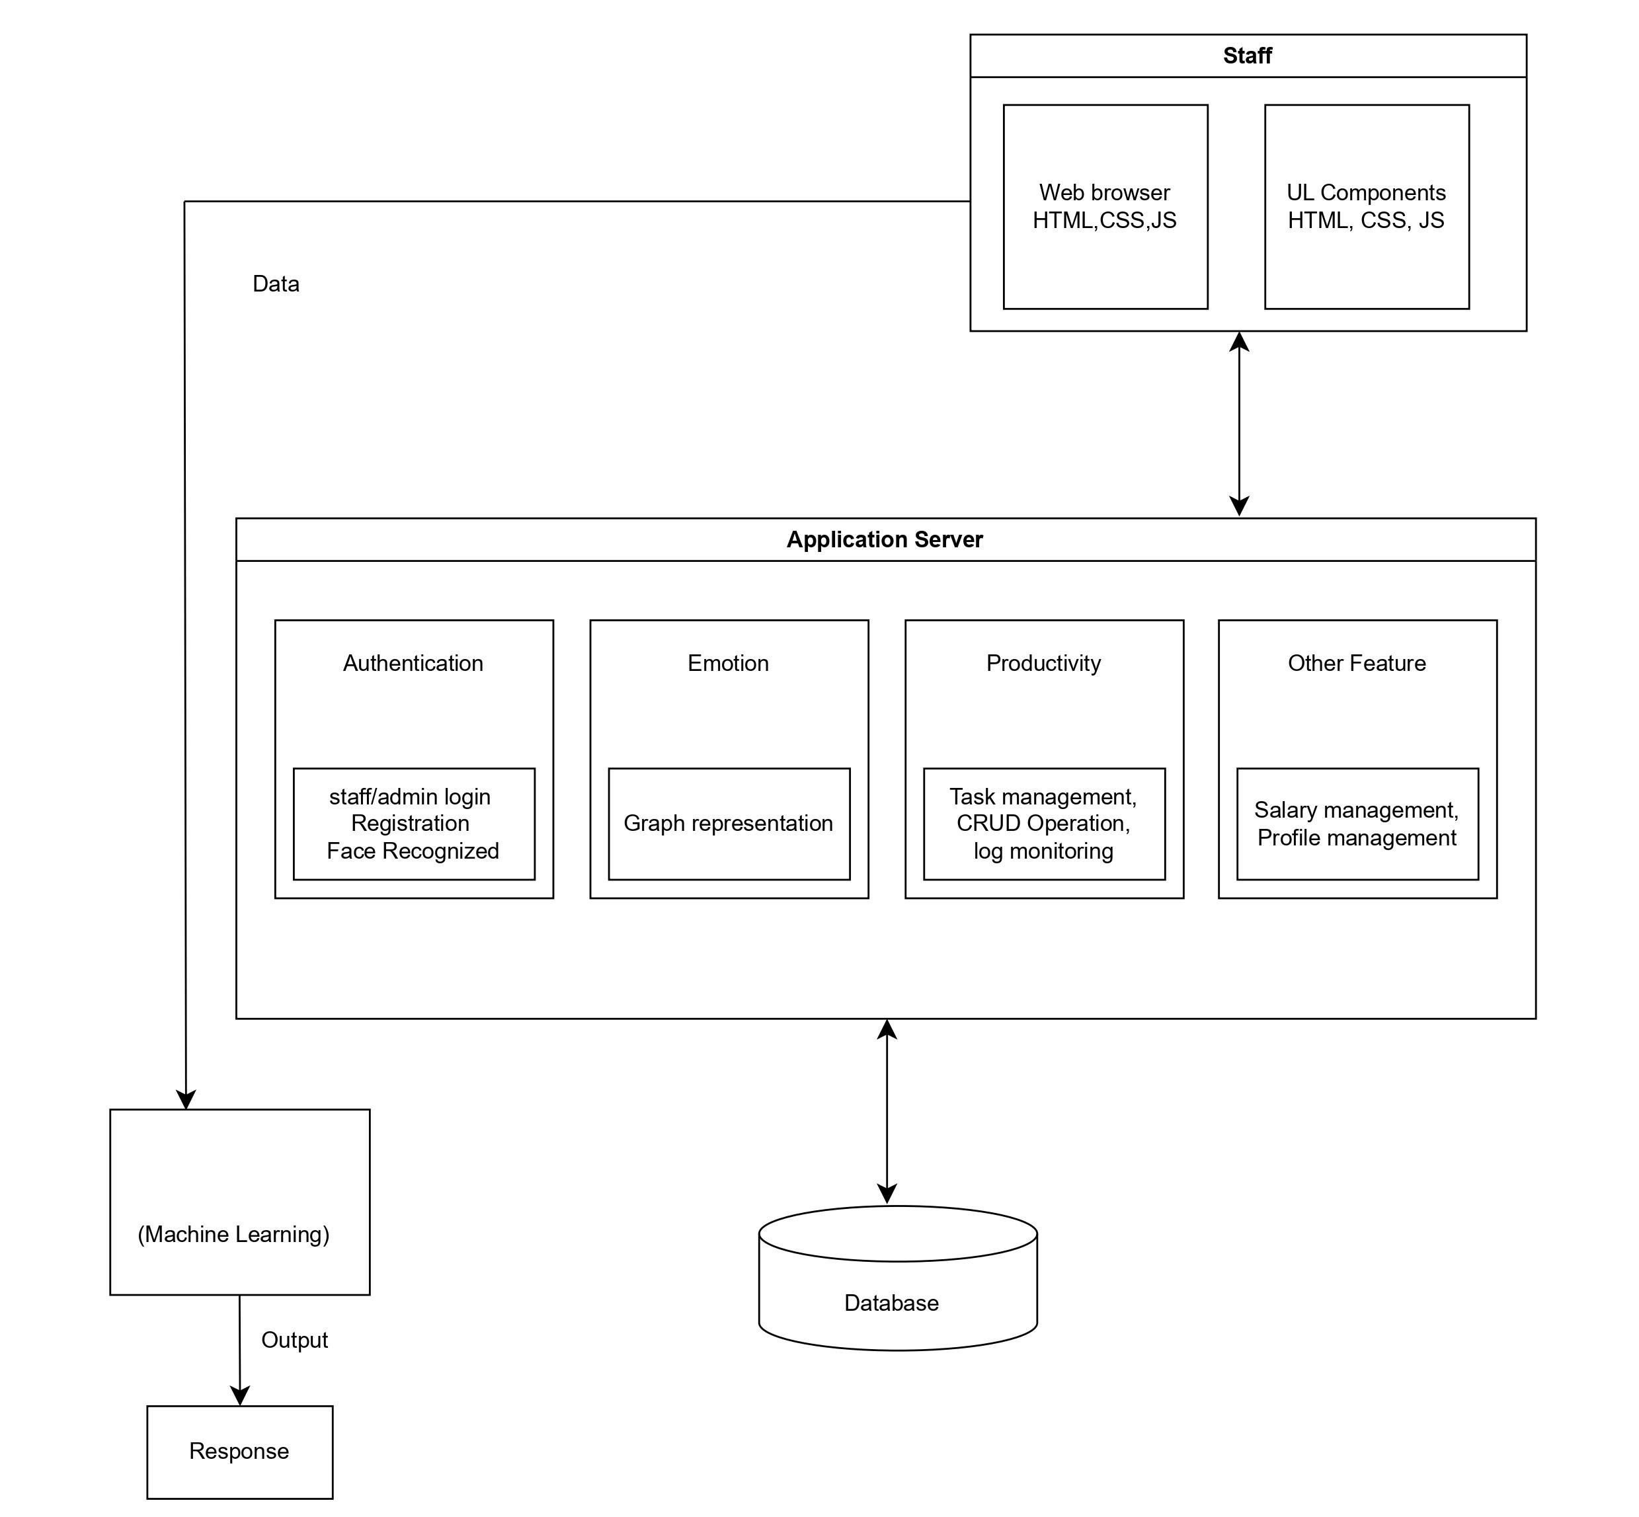
CNN + LSTM

Slide 16
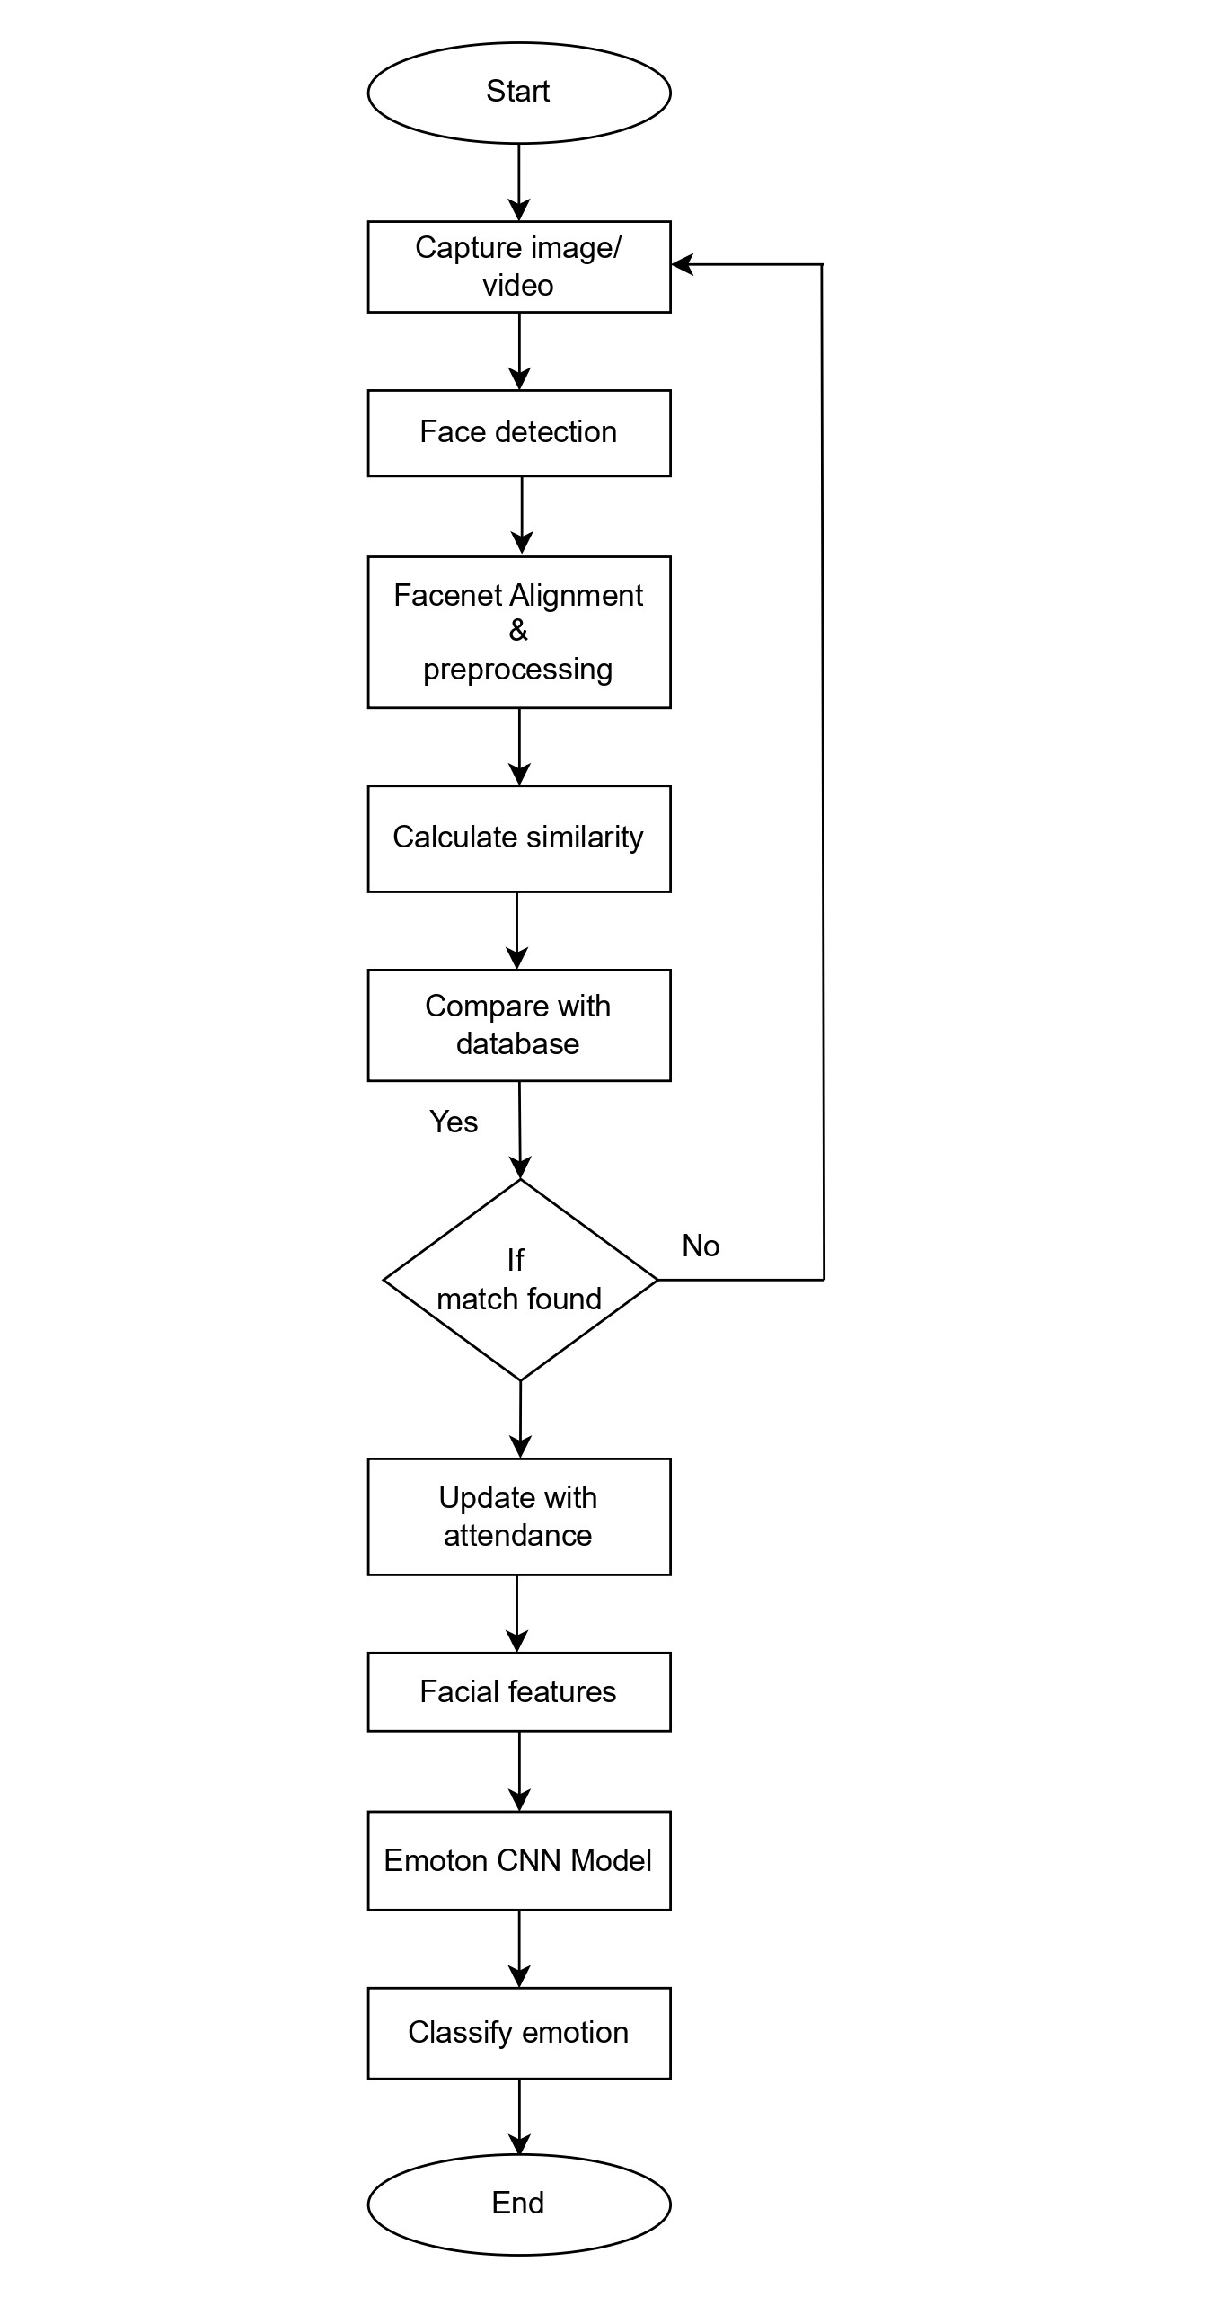
Flow Chart

Slide 17
Register Table
Register_id: Primary key,staff_id: foregin key
Field | Datatype | Description
staff_id | INT | Unique ID for each staff member
register_id | INT | Unique ID for each register record
name | VARCHAR(100) | Full name of the staff
email | VARCHAR(500) | Staff email address
phone_no | VARCHAR(15) | Staff phone number
password | VARCHAR(15) | Login password
Profile_image | BLOB/LONGBLOB | Profile image file
face_embedding | JSON | List of float numbers representing face encoding
face_capture | BLOB/LONGBLOB | Live face-captured image
role | ENUM('admin', 'staff') | Type of user
gender | VARCHAR(10) | Gender of the staff
dob | DATE | Date of birth
place | VARCHAR(100) | Native or residing place
city | VARCHAR(100) | City of residence
state | VARCHAR(100) | State of residence
country | VARCHAR(30) | User's country
Pin_code | VARCHAR(10) | Postal code
job_type | VARCHAR(100) | Department type
created_at | DATETIME | Record creation Timestamp
Notes:
face_data VARBINARY(2048)

Slide 18
Staff Table
Register_id: Primary key, staff_id: Primary key
Field | Datatype | Description
staff_id | INT | Unique ID for each staff member
name | VARCHAR(100) | Full name of the staff
email | VARCHAR(500) | Staff email address
Profile_image | BLOB/LONGBLOB | Profile image file
System_id | INT | System generated or device ID for attendance / face recognition
role | ENUM('admin', 'staff') | Type of user
gender | VARCHAR(10) | Gender of the staff
job_type | VARCHAR(100) | Department type
created_at | DATETIME | Record creation Timestamp
check_in | TIME | Check-in time for staff
check_out | TIME | Check-out time for staff
Notes:
face_data VARBINARY(2048)

Slide 19
Attendance Table
attendance_id : primary key staff_id : foreign key
Field | Data type | Description
attendance_id | INT | Unique ID for each attendance record
staff_id | INT | Reference to staff
date | DATE | The date of attendance (defaults to today)
check_in | TIME | Check-in time of staff
check_out | TIME | Check-out time of staff
overtime_hours | TIME | Logout / check-out time
overtime_hours | DECIMAL | Number of overtime hours worked
status | ENUM ('Present', 'Absent', 'Leave') | Attendance status

Slide 20
Emotion Table
emotion_id : primary key staff_id : foreign key
Field | Datatype | Description
emotion_id | INT | Unique emotion ID
staff_id | INT | Staff Reference
emotion_type | ENUM('Happy', 'Sad', 'Neutral', 'Angry', 'Tired', 'Focused') | Detected emotion type
timestamp | TIMESTAMP | Time of detection

Slide 21
Productivity Table
productivity_id : primary key staff_id : foreign key
Field | Datatype | Description
productivity_id | INT | Unique productivity ID
staff_id | INT | Staff Reference
datetime | TIMESTAMP | The time update
keystroke | INT | Total number of keystrokes (keyboard presses) recorded during a work session, used to measure typing activity
mouse_moves | INT | Total count of mouse movements or clicks detected during the session, used to monitor activity
productivity_score | DECIMAL | Calculated score representing overall productivity based on activity metrics (e.g., keystrokes, mouse movement, and task completion)

Slide 22
Work Schedule Table
schedule_id : primary key staff_id : foreign key
Field | Datatype | Description
schedule_id | INT | Unique id for each work schedule
staff_id | INT | Staff reference
title | VARCHAR(100) | Name of the work assigned
description | TEXT | Detailed explanation of the task
assigned_date | DATE | Date when the task was assigned
due_date | DATE | Deadline for the work
completed_date | DATE | Date when the task was completed
status | ENUM('pending','completed','Rescheduled','Incomplete') | Current state of the task Default = pending
admin_notes | TEXT | Notes added by admin about the task
staff_response | TEXT | Staff feedback, reschedule reason,or comments.
created_at | DATETIME | Auto timestamp:when record was created
updated_at | DATETIME | Auto timestamp:when record was last updated

Slide 23
GooglemeetTable
meet_id : primary key
Field | Datatype | Description
meet_id | INT AUTO_INCREMENT | Unique identifier for each Google Meet session
Job_type | VARCHAR(10) | Job type or work category related to the meeting
meet_time | DATETIME | Scheduled date and time of the meeting
meet_title | VARCHAR(50) | Title or subject of the Google Meet
meet_description | TEXT | Detailed description or agenda of the meeting
meet_link | VARCHAR(50) | Google Meet URL used to join the meeting

Slide 24
Thank you

